Slide 1
Disaster Management
INFORMATION, REPRESENTATION, PROCESSING & VISUALIZATION
Akshay Bitra
G01087950

Slide 2
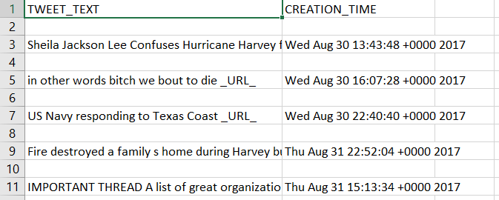
MILESTONE 1: Data Acquisition
The data was imported into R and figured out that it is not clean dataset i.e. it consists of NA’s/Missing values.

Slide 3
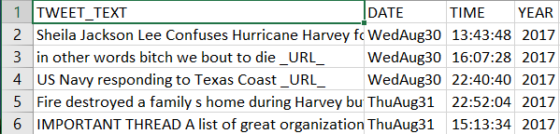
MILESTONE 2: Data Preprocessing
I have used the Excel to separate the CREATION_TIME to Date, Time and Year columns respectively and to also delete the alternate empty rows.
I cleaned the TWEET_TEXT column, removed the unnecessary characters. For example, the _URL_, two letter words etc.

Slide 4
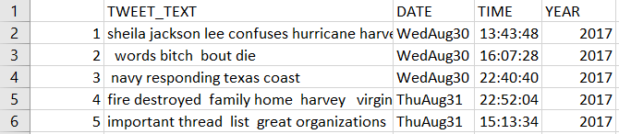
Cont.
The data looks like this after the deletion of stop words.

Slide 5
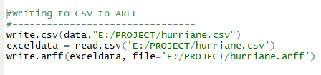
MILESTONE 3: Mining Tool Preparation
This Milestone needs the file to be loaded to Weka, I have converted the CSV to ARFF with the help of R.

Slide 6
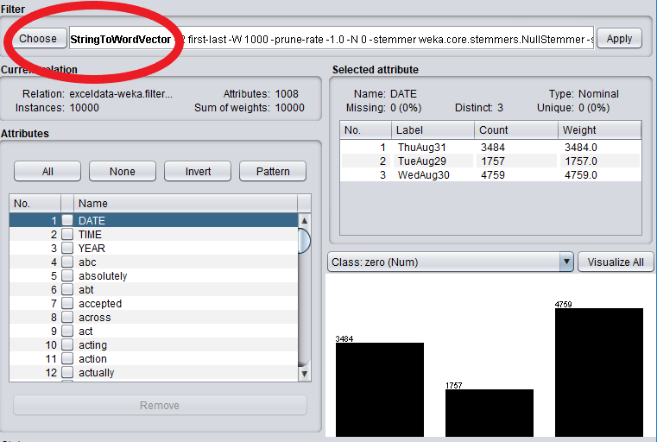
Cont.
It is converted to ARFF as the TWEET is nominal.
Steps: Supervised Learning -> Attributes->Nominal to String->String to Word Vector Filters.

Slide 7
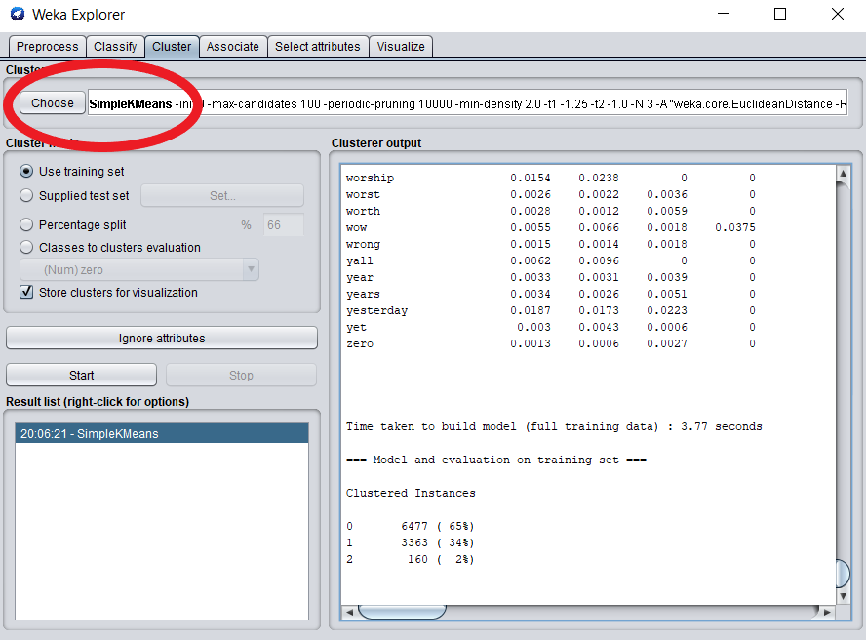
MILESTONE 4: Clustering Analysis
Simple K-means algorithm is used in this Milestone and applied on the TWEET column, here K is set to 3.

Slide 8
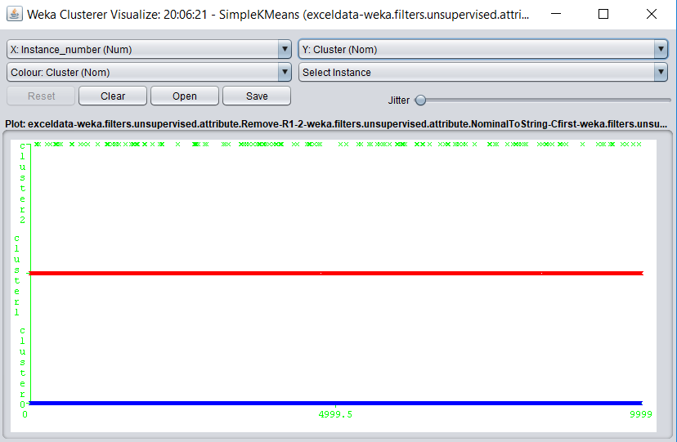
Cont.
The Inter cluster distance is maximized and intra cluster distance is minimized.

Slide 9
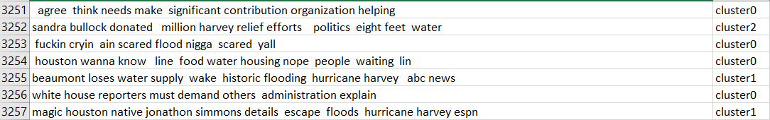
MILESTONE 5: Visualization
The output of ARFF is converted to CSV for visualizing the data.

Slide 10
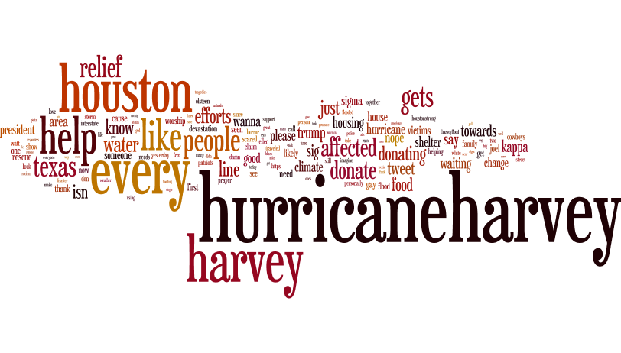
Word Clouds
Cluster-0

Slide 11

Cont.
Cluster-1

Slide 12
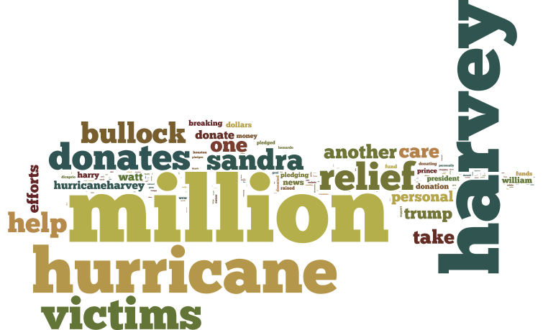
Cont.
Cluster-2

Slide 13
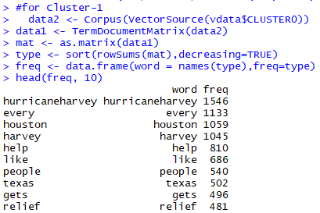
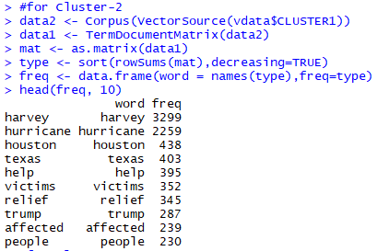
Top 10 Words

Slide 14
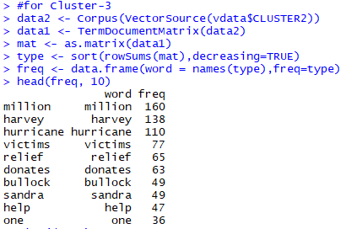
Cont.
Insights retrieved from the top 10 words for each Cluster.
Cluster-1: Hurricane Harvey at Houston gets Relief from people.
Cluster-2: Trump helped Hurricane Harvey affected people in Texas.
Cluster-3: Sandra Bullock donates one Million for Harvey Relief.

Slide 15


